Slide 1
Designing a PID controller with analog input and analog output signals using digital and analog components for laboratory use
Pranabendra Prasad Chandra
001610801122

Slide 2
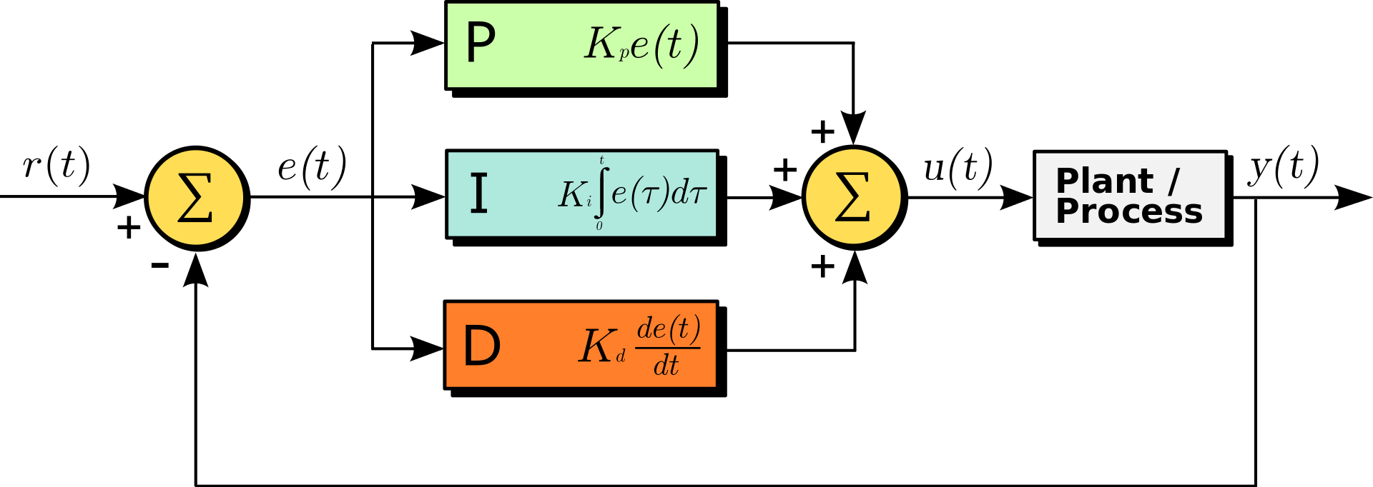
Block Diagram of a PID controller in a loop
Image Source: PID Controller – Wikipedia (Link)

Slide 3
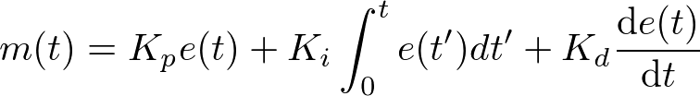
PID Equation in Continuous Time
In continuous time domain, the PID equation is given as,
Where,
m(t) = controller output
e(t) = error signal

Slide 4
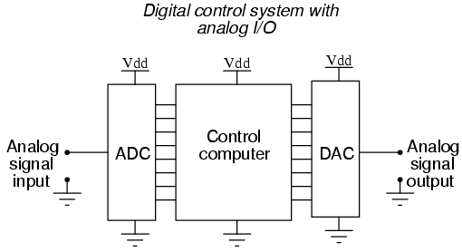
Image Source: DAC – All About Circuits (Link)

Slide 5
Digital Controller Equations
Let the sampling frequency be f_{s}
Therefore, the sampling time becomes, τ = 1/ f_{s}
Replacing t by nτ , in discrete domain, the PID equation becomes
Trapezoidal Integration
Backward Difference

Slide 6
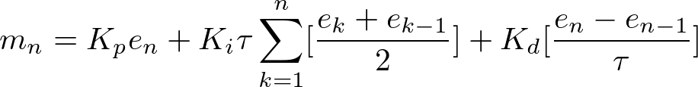
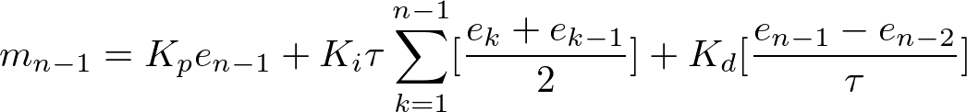





Slide 7
Design Specifications
Maximum voltage input = 230V AC, ±340V DC
Sampling frequency = Maximum 9 kHz in Arduino Uno (Will try ESP-32)

Slide 8
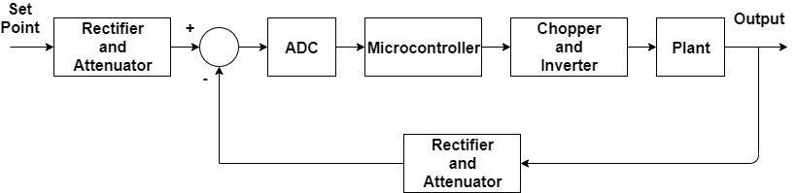
Block Diagram

Slide 9
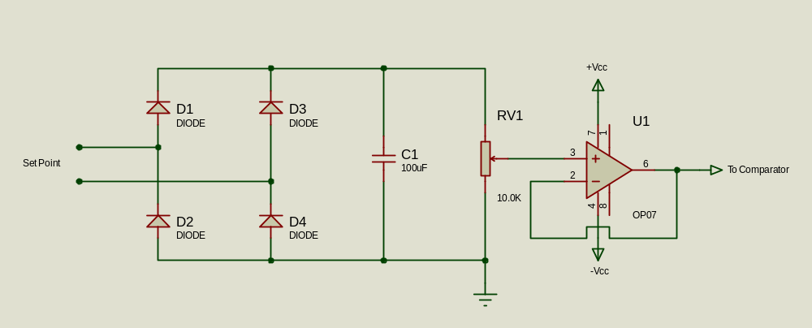
Rectifier and Attenuator

Slide 10
References
Digital Controller Notes by Anjan Rakshit and Amitava Chatterjee
Mohan, N., Undeland, T.M. and Robbins, W.P., 2003. Power electronics: converters, applications, and design. John wiley & sons.
Shinskey, F.G., 1979. Process control systems. McGraw-Hill, Inc..
Tools used
Proteus 8 (Circuit Schematic Diagram)
Latex2PNG (Writing Equations)
Draw.io (Block Diagram)

